Slide 1
Django Installation

Slide 2
Week1 tutorial
https://docs.djangoproject.com/en/3.0/intro/tutorial01/

Slide 3
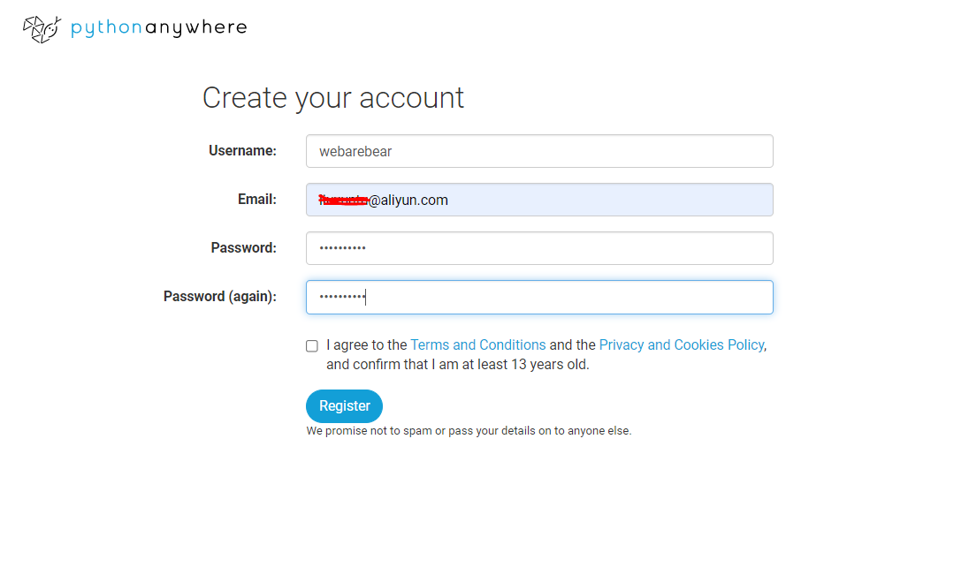
Create account
https://www.pythonanywhere.com/registration/register/beginner/

Slide 4
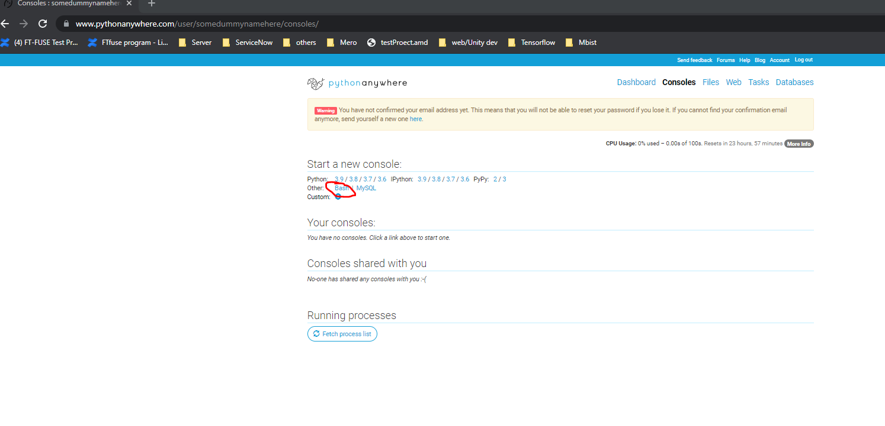
Click on bash

Slide 5
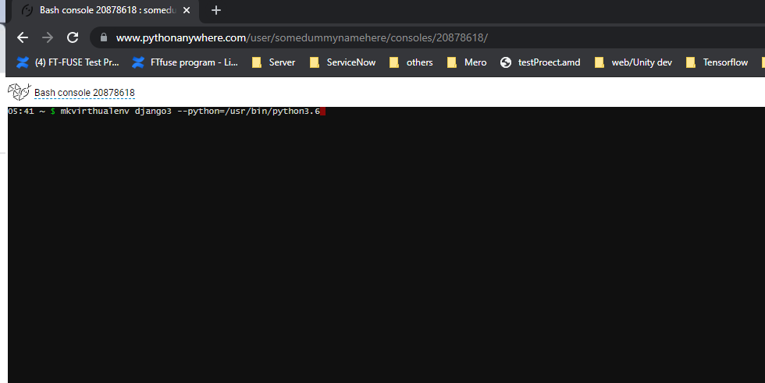
Create virtual environment
mkvirtualenv django3 --python=/usr/bin/python3.6

Slide 6
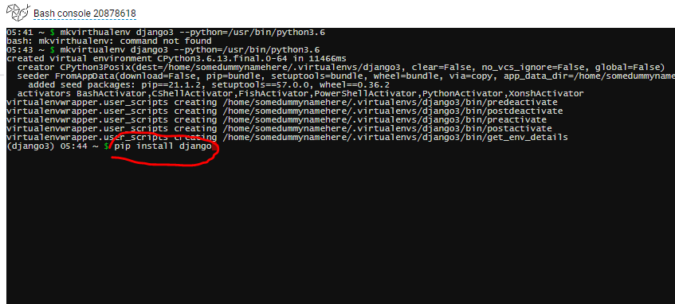
Install Django
pip install Django
Notes:
It may takes a while for the installation ….

Slide 7
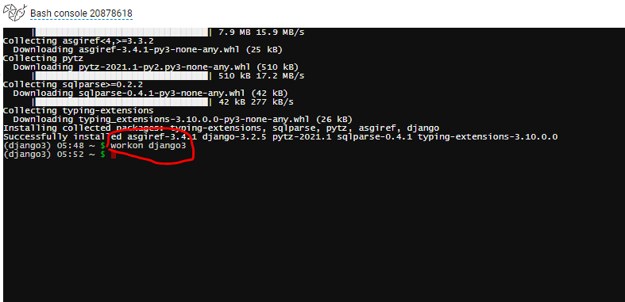
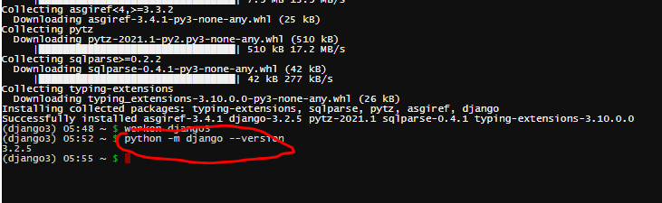
Workon django3 and python –m Django --version
workon django3
python –m django --version
Notes:
Make sure Django was installed successfully

Slide 8
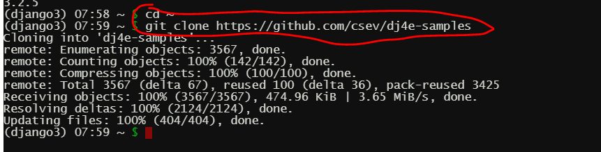
Clone sample codes
cd ~
git clone https://github.com/csev/dj4e-samples

Slide 9
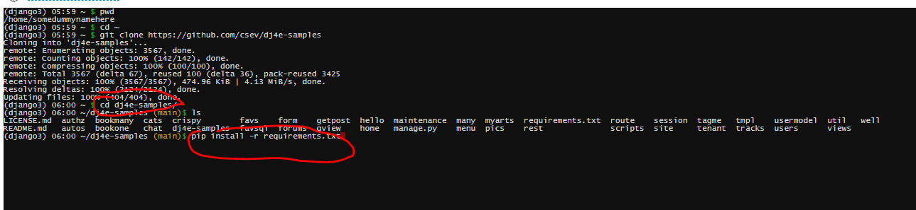
Install library
cd dj4e-samples
pip install –r requirements.txt

Slide 10
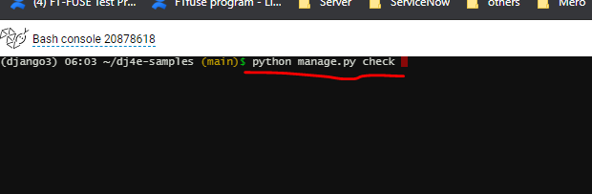
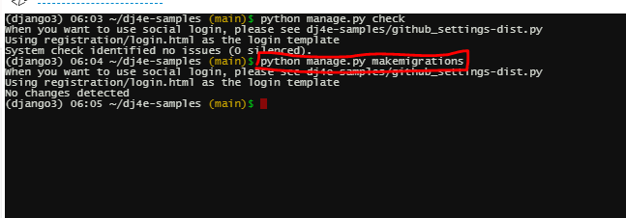
python manage.py check & python manage.py makemigrations
python manage.py check
python manage.py makemigrations

Slide 11
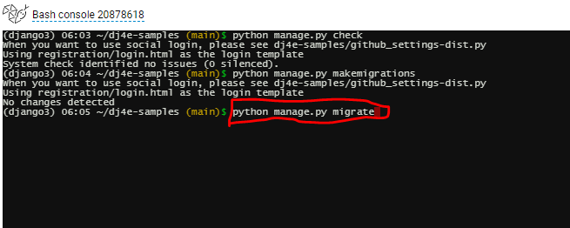
python manage.py migrate
python manage.py migrate

Slide 12
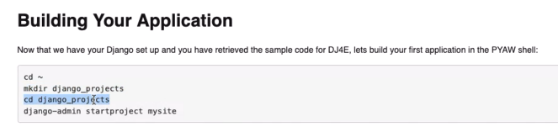
Build application

Slide 13
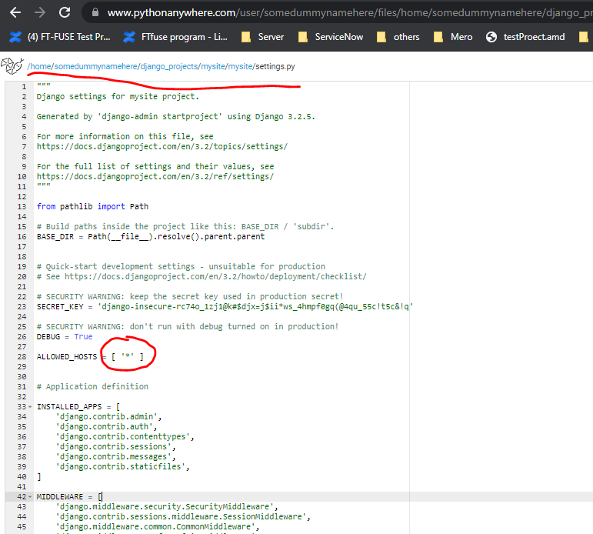
Edit settings file

Slide 14
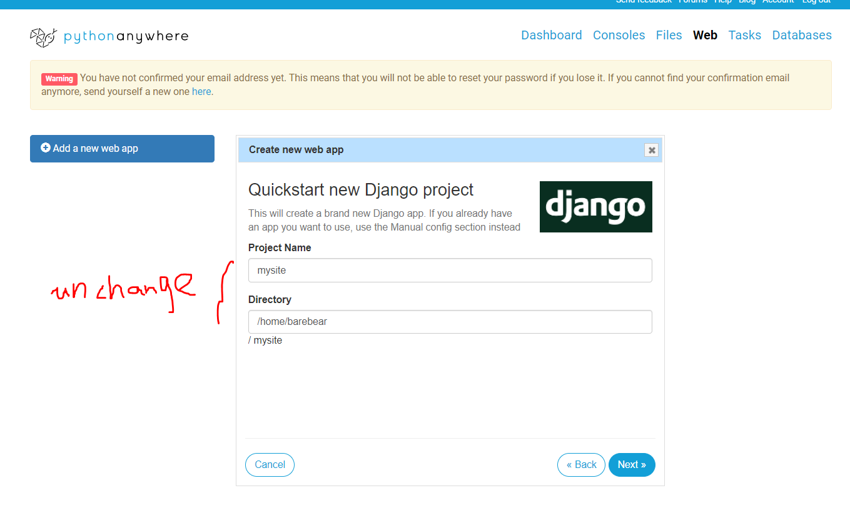
Click “Add a new web app”

Slide 15
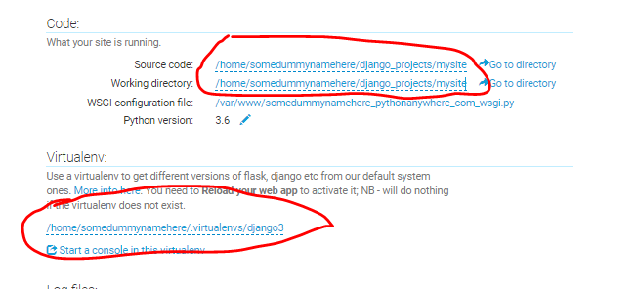
Check source code/ working directory
Source code and working directory should point to the same directory
Input virtual environment

